Slide 1
Maurice Pérol
Prise en charge des CBNPC stade IV sans addiction oncogénique :
Où en est-on en 2019?
Centre Léon Bérard, Lyon
maurice.perol@lyon.unicancer.fr

Slide 2
Disclosures
Advisory Boards : Roche, Genentech, Eli Lilly, Pfizer, Boehringer-Ingelheim, Clovis Oncology, MSD, Bristol-Myers Squibb, Novartis, Pierre Fabre, AstraZeneca, Takeda
Fonds de recherche institutionnels: Roche, AstraZeneca, Chugai, Takeda
Symposiums: Eli Lilly, Roche, AstraZeneca, Pfizer, Amgen, Boehringer-Ingelheim, Bristol-Myers Squibb, Takeda, MSD, Chugai

Slide 3
Prise en charge des CBNPC stade IV sans addiction oncogénique : où en est-on en 2019?
  Le passé : les progrès incrémentaux liés à la chimiothérapie
  Les stratégies de développement de l’immunothérapie en 1ère ligne
  Un nouvel algorithme
  Le nouveau désert de la seconde ligne

Slide 4
The past
Incremental advances
due to cytotoxic chemotherapy

Slide 5
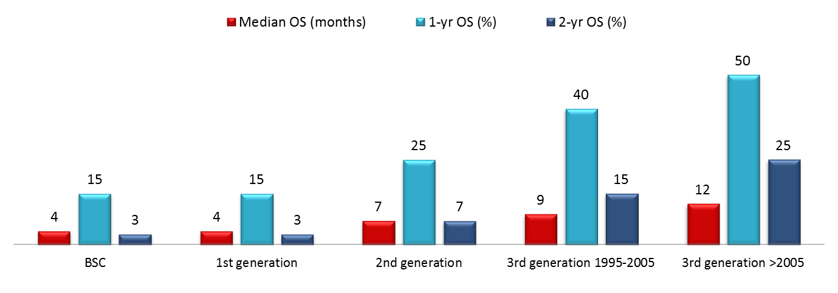
Incremental Improvements: 1980-2010
Which reasons for OS improvement?
3rd generation cytotoxic agents are a little bit more active
More treatment lines and maintenance strategy
Emergence of targeted therapies
More stringent selection in clinical trials (PS 0-1 …)
Stage migration
Increase of female proportion
Improvement of brain metastases treatment
Improvement of supportive care
Noonan K, JTO 2015

Slide 6
The Two Strategies
of Immunotherapy Development
in 1st Line Treatment of NSCLC

Slide 7
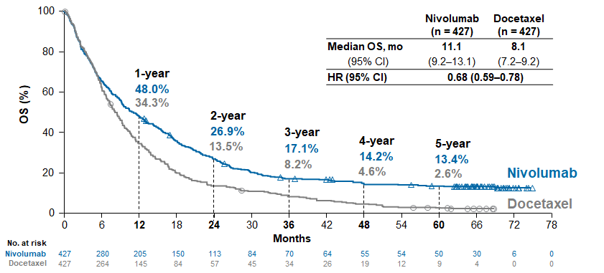
5-Year Pooled OS: Nivolumab vs. Docetaxel
Gettinger, WCLC 2019

Slide 8
First strategy of ICIs development in 1st line treatment of advanced NSCLC
Immunotherapy
instead of
chemotherapy
Selection of patients
on predictive biomarkers
PD-L1
Anti-PD(L)-1
as single agent
TMB
Anti-PD(L)-1
+ anti-CTLA-4

Slide 9
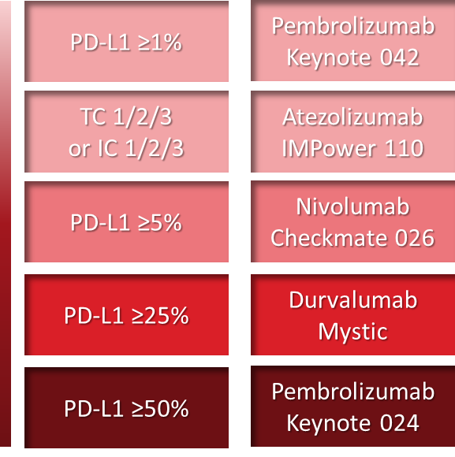
Strategy for using ICIs in 1st line
To replace cytotoxic chemotherapy
Immunotherapy
instead of
chemotherapy
Selection of patients
on predictive biomarkers
PD-L1
Anti-PD(L)-1
as single agent

Slide 10
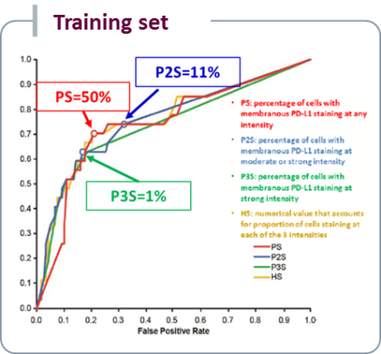
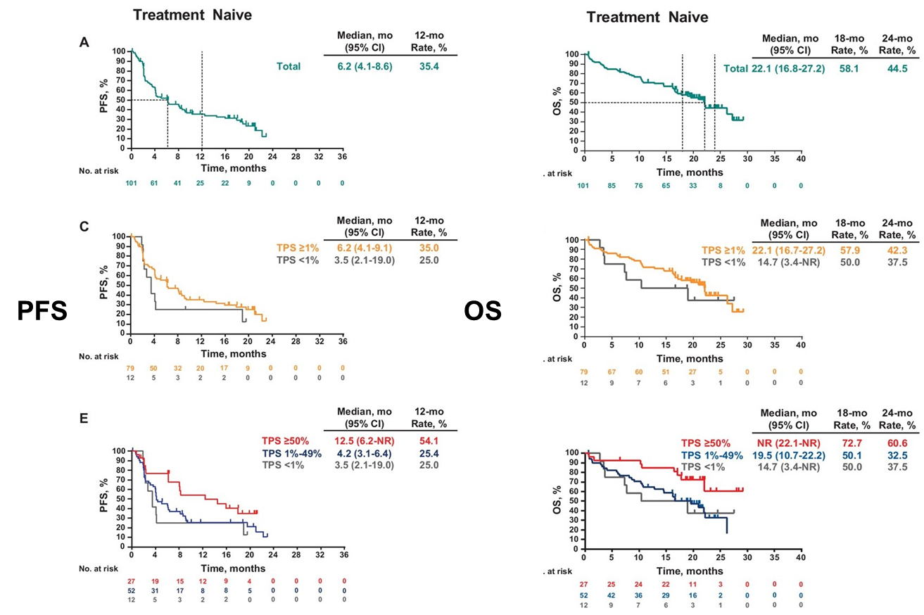
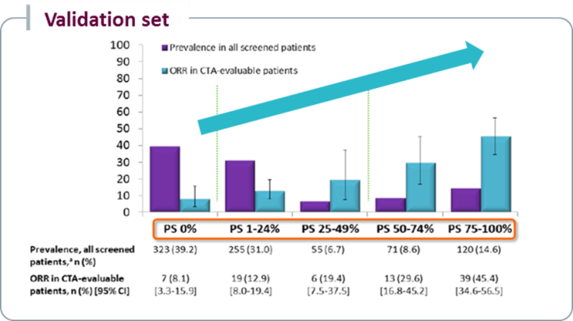
Keynote 001
Selection of a cutoff of PD-L1 expression for 1st line
Garon, NEJM 2015; Hui, ASCO 2016

Slide 11
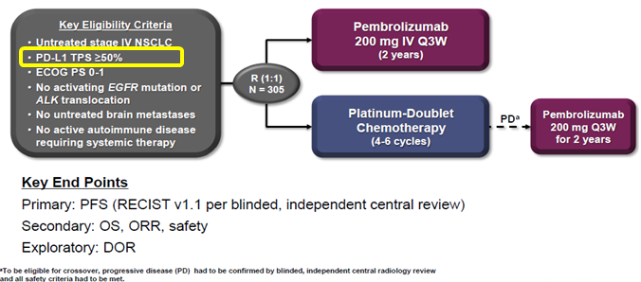
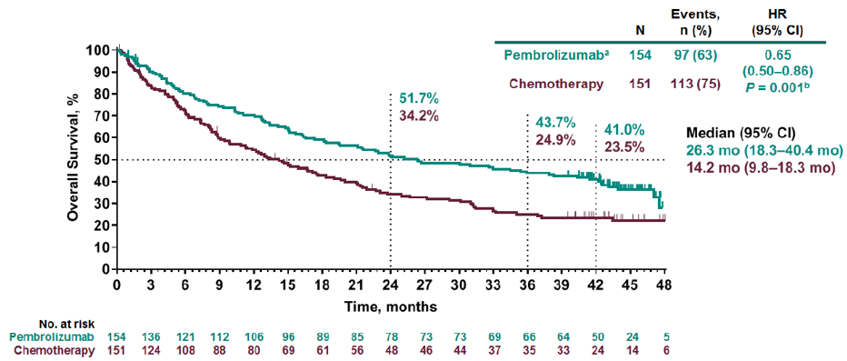
Pembrolizumab in 1st line for PD-L1 ≥50% NSCLC: Keynote 024
Crossover rate: 64.9% (ITT)
Median follow up: 44.4 months
Reck, NEJM 2016; Reck, WCLC 2019

Slide 12
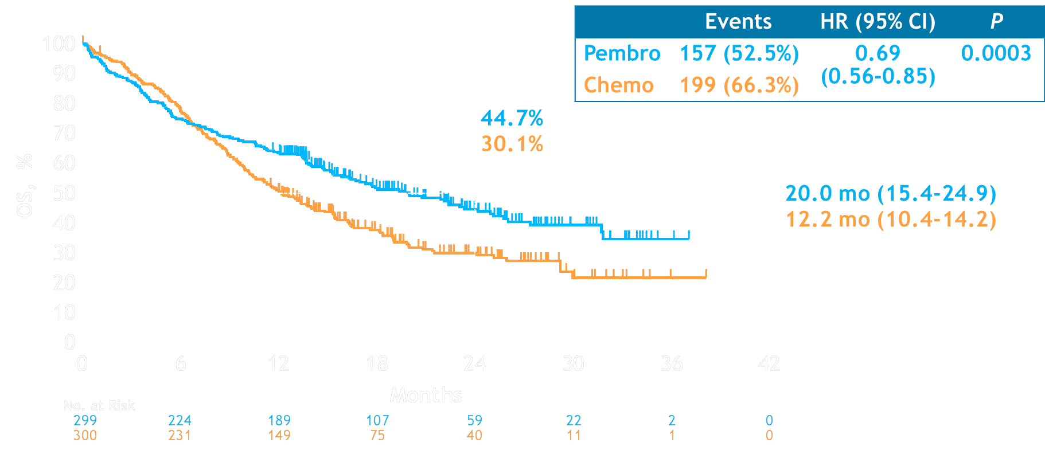
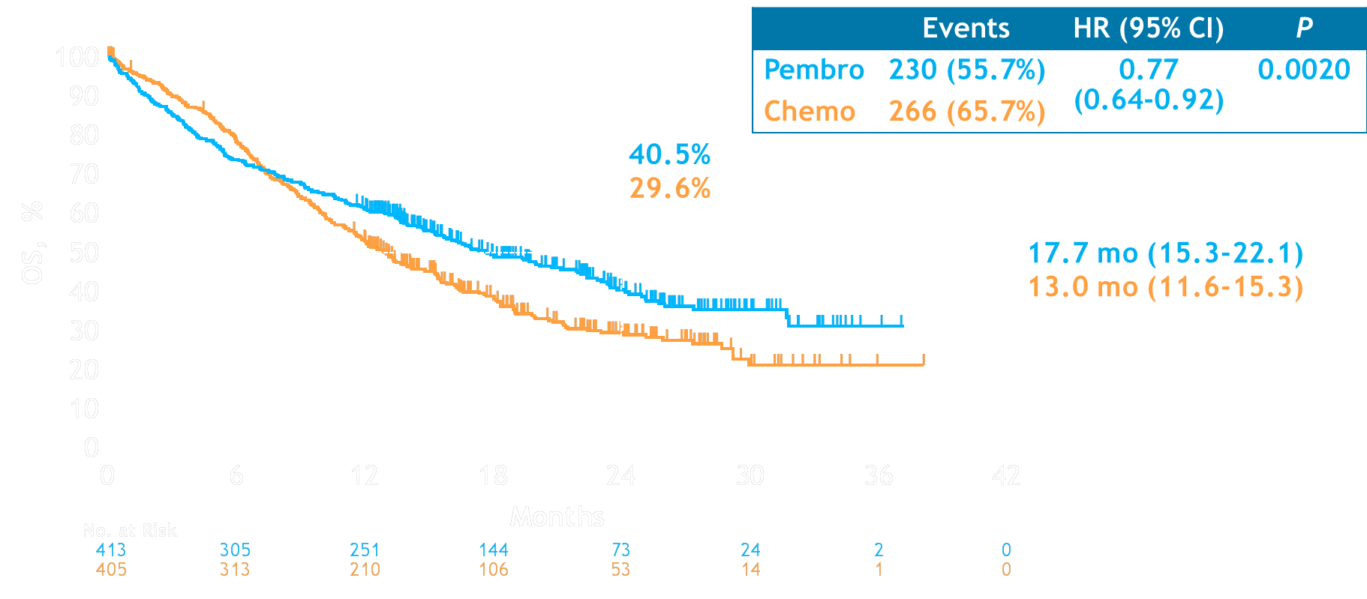
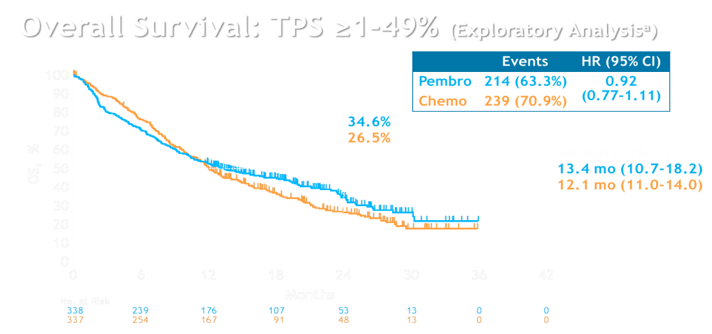
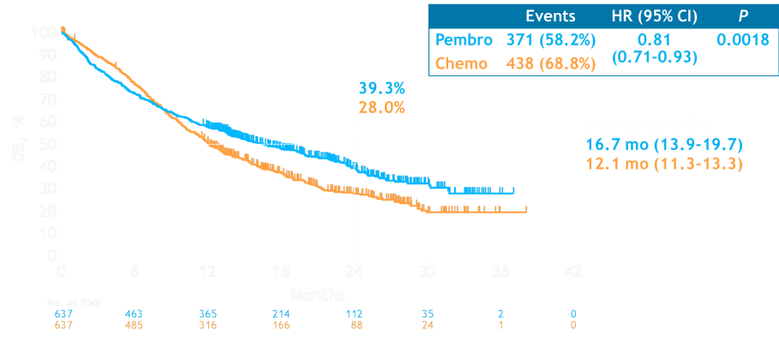

Keynote 042: pembrolizumab vs. chemotherapy in PD-L1 ≥1% advanced NSCLC: overall survival
TPS ≥50%
TPS ≥20%
≥1%
≥20%
Benefit
≥50%
Crossover to immunotherapy: 19.8%
TPS ≥1%
Lopes, ASCO 2018; Mok, Lancet 2019

Slide 13
Anti-PD(L)-1 as single agent in 1st line
PD-L1 level of expression does matter
PD-L1
Anti-PD(L)-1 monotherapy
PD-L1 ≥1%
Pembrolizumab
Keynote 042
HR OS
HR 0.81 (95% CI 0.71-0.93)
PD-L1 ≥5%
Nivolumab
Checkmate 026
HR 1.02 (95% CI 0.80-1.30)
PD-L1 ≥50%
Pembrolizumab
Keynote 024
HR 0.63 (95% CI 0.47-0.86)
PD-L1 ≥25%
Durvalumab
Mystic
HR 0.76 (97.54% CI 0.56-1.02)
Lopes, ASCO 2018; Mok, Lancet 2019; Carbone, NEJM 2017; Reck, JCO 2019; Rizvi, ESMO-IO 2018

Slide 14
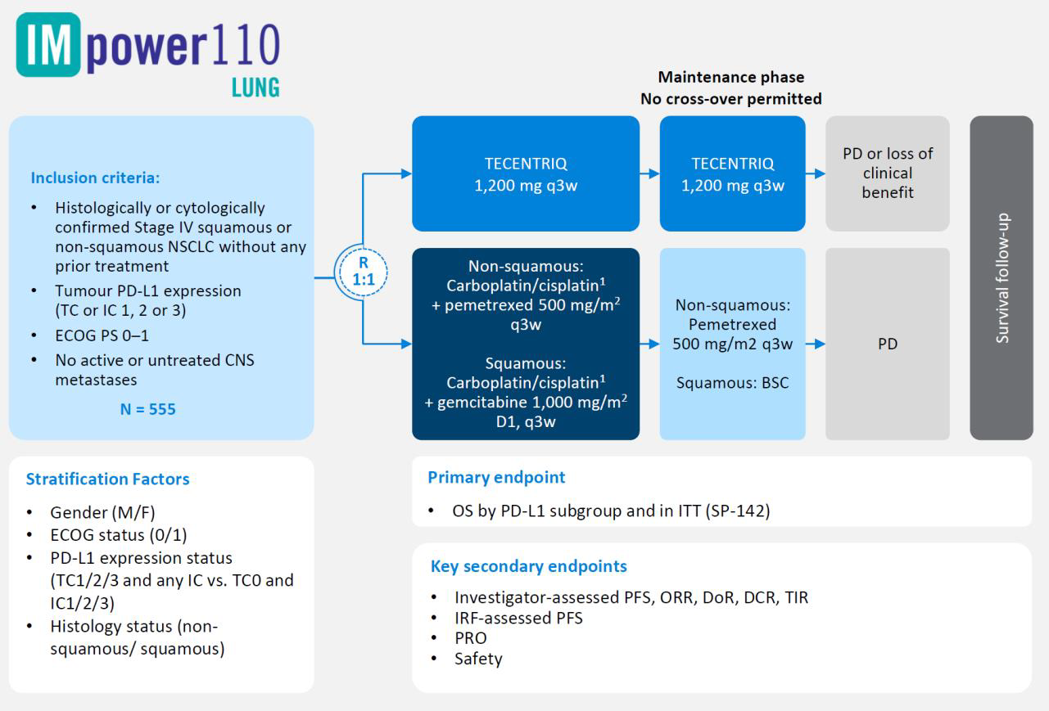
Completed 1st line trials
12 Sept 2019
Atezolizumab monotherapy demonstrated
a statistically significant overall survival (OS) benefit
in people with high PD-L1 expression (TC3/IC3-WT),
compared with chemotherapy alone.
ESMO 2019

Slide 15
Strategy for using ICIs in 1st line
To replace cytotoxic chemotherapy
Anti-PD(L)-1
+ anti-CTLA-4
Immunotherapy
instead of
chemotherapy
Selection of patients
on predictive biomarkers
PD-L1 ≥25%
Durvalumab
+ Tremelimumab
Mystic
PD-L1 ≥1%
TMB ≥10 mut/Mb
Nivolumab
+ Ipilimumab
CheckMate 227
bTMB ≥20 mut/Mb
Durvalumab
+ Tremelimumab
Neptune

Slide 16
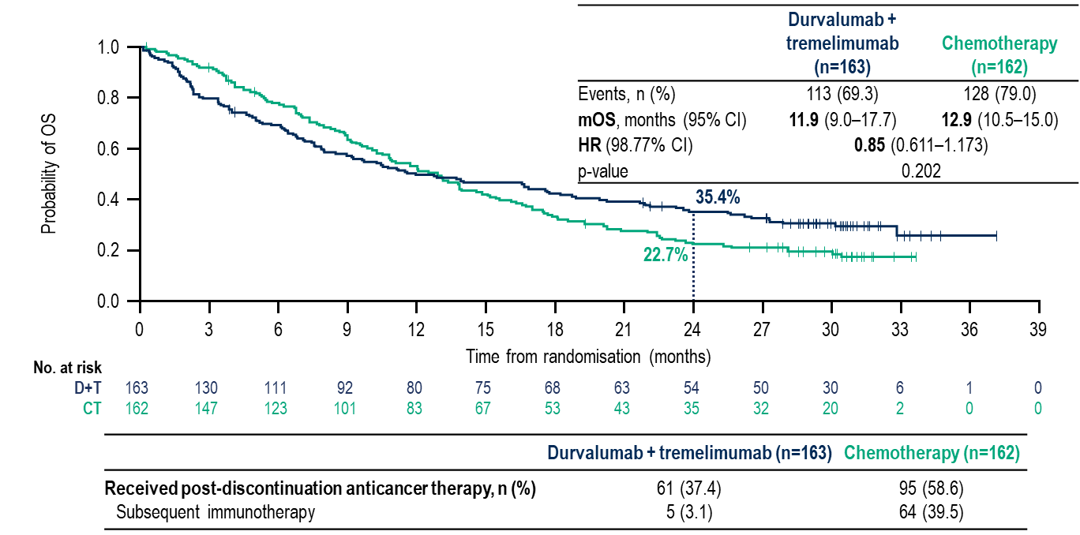
Mystic: Durvalumab + Tremelimumab vs. Chemotherapy in PD-L1 ≥25% NSCLC
Rizvi, ESMO IO 2018

Slide 17
CheckMate 227 Part 1 Study Design
PD-L1 ≥1%
Nivolumab 3 mg/kg Q2W
Ipilimumab 1 mg/kg Q6W
n = 396
Nivolumab + ipilimumab
n = 396
N = 1189
≥1% PD-L1
expression
R
1:1:1
Histology-based chemotherapy^{b}
n = 397
Chemotherapy^{b}
n = 397
Nivolumab 240 mg Q2W
n = 396
24 JUL 2019
Bristol-Myers Squibb announces CheckMate -227 Part 1a
meets co-primary endpoint of overall survival
Study met its co-primary endpoint of overall survival with nivolumab plus low dose ipilimumab vs. chemotherapy in first-line non-small cell lung cancer patients whose tumors express PD-L1 ≥1%
ESMO 2019
Key Eligibility Criteria
Stage IV or recurrent NSCLC
No prior systemic therapy
No known sensitizing EGFR/ALK alterations
ECOG PS 0–1
Stratified by SQ vs NSQ
Nivolumab 3 mg/kg Q2W
Ipilimumab 1 mg/kg Q6W
n = 187
N = 550
<1% PD-L1
expression
R
1:1:1
Co-primary endpoints: Nivolumab + ipilimumab vs chemotherapy
OS in PD-L1–selected populations
Histology-based chemotherapy^{b}
n = 186
Nivolumab 360 mg Q3W +
histology-based chemotherapy^{b}
n = 177
Hellmann, NEJM 2018

Slide 18
CheckMate 227 Part 1 Study Design
Patients for PD-L1 co-primary analysis
Nivolumab 3 mg/kg Q2W
Ipilimumab 1 mg/kg Q6W
n = 396
Nivolumab + ipilimumab
n = 396
N = 1189
≥1% PD-L1
expression
R
1:1:1
Histology-based chemotherapy^{b}
n = 397
Chemotherapy^{b}
n = 397
Nivolumab 240 mg Q2W
n = 396
Patients for TMB co-primary analysis^{c}
Key Eligibility Criteria
Stage IV or recurrent NSCLC
No prior systemic therapy
No known sensitizing EGFR/ALK alterations
ECOG PS 0–1
Stratified by SQ vs NSQ
Nivolumab + ipilimumab
n = 139
Chemotherapy^{b}
n = 160
Nivolumab 3 mg/kg Q2W
Ipilimumab 1 mg/kg Q6W
n = 187
N = 550
<1% PD-L1
expression
R
1:1:1
Co-primary endpoints: Nivolumab + ipilimumab vs chemotherapy
OS in PD-L1–selected populations
PFS in TMB-selected populations
Histology-based chemotherapy^{b}
n = 186
Nivolumab 360 mg Q3W +
histology-based chemotherapy^{b}
n = 177
Hellmann, NEJM 2018

Slide 19
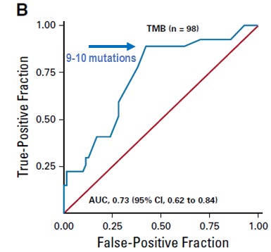
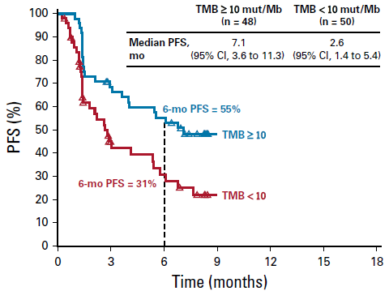
Selection of a TMB cut off for ipilimumab-nivolumab combination in CheckMate 568
Ready N et al, JCO 2019

Slide 20
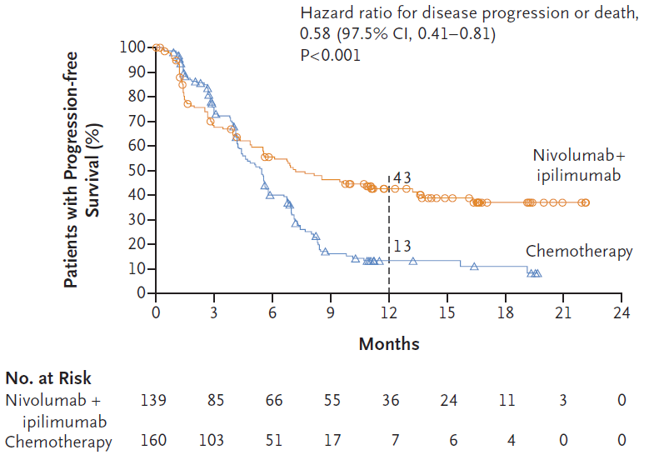
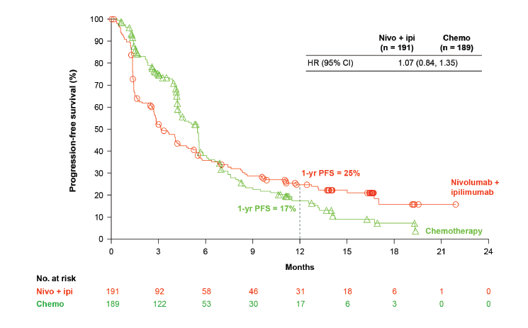
CheckMate 227 : nivolumab + ipilimumab vs. chemotherapy in 1st line: PFS according to TMB
TMB ≥10 mut/Mb
TMB <10 mut/Mb
Hellmann, NEJM 2018

Slide 21
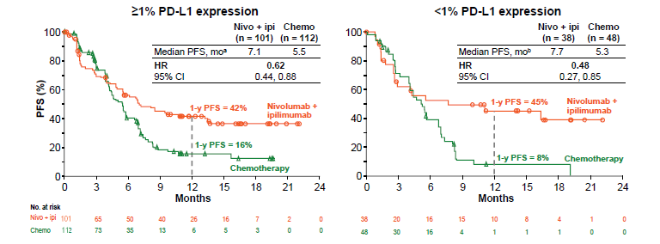
CheckMate 227 : nivolumab + ipilimumab vs. chemotherapy in 1L with TMB ≥10 mut/Mb
PFS in patients with High TMB (≥10 mut/Mb) by Tumor PD-L1 Expression
Hellmann, NEJM 2018

Slide 22
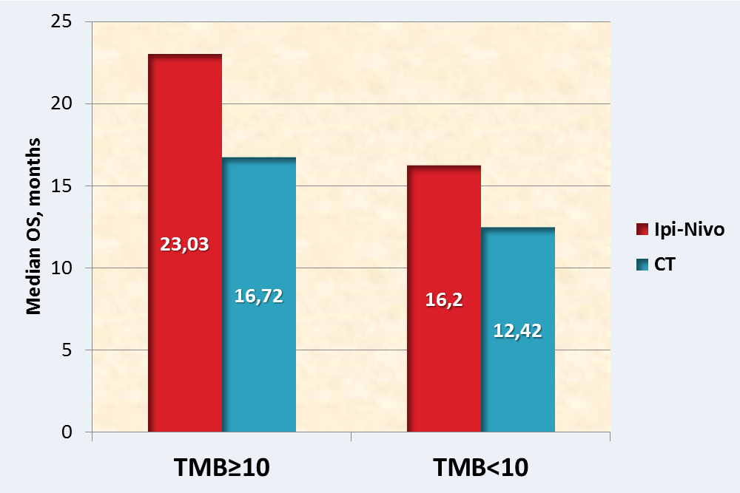
Preliminary Overall Survival with Nivolumab + Ipilimumab vs. Chemotherapy in Patients with High TMB (≥10 Mut/Mb)
 | Nivo + ipi (n = 139) | Chemo (n = 160)
Median OS,^{b} mo | 23.0 | 16.4
HR 95% CI | 0.79 0.56, 1.10
100
0.77 (95% CI: 0.56 to 1.06)
80
1-y OS = 67%
60
0.78 (95% CI: 0.61 to 1.00)
Nivolumab + ipilimumab
OS (%)ª
1-y OS = 58%
Chemotherapy
40
20
0
0
3
6
9
12
15
18
21
24
27
30
No. at risk
Months
Nivo + ipi
139
120
112
98
90
71
44
16
5
0
0
Chemo
160
148
129
104
90
75
45
23
9
1
0
Database lock: March 15, 2018; minimum follow-up: 14.2 months; 53% of patients were censored
In the chemotherapy arm, 31.3% received subsequent immunotherapy (38.3% among those with disease progression^{c})
Hellmann, NEJM 2018

Slide 23
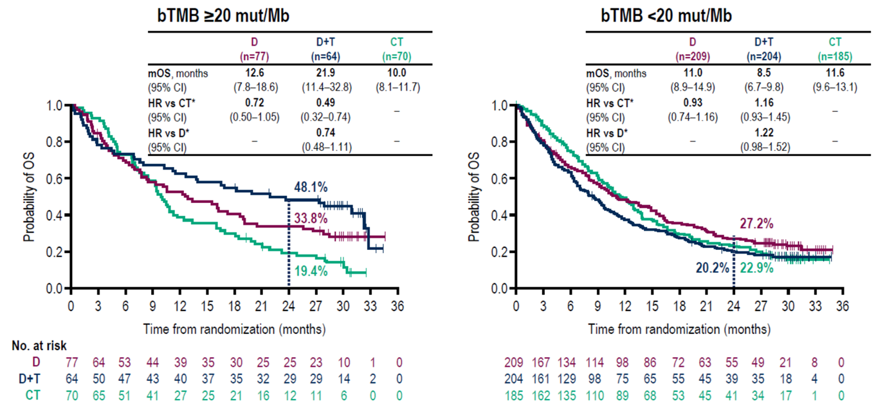
TMB can be predictive of OS benefit from anti-PD(L)-1 ± anti-CTLA-4 therapy
Peters S et al;, AACR 2019

Slide 24

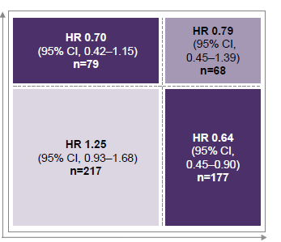
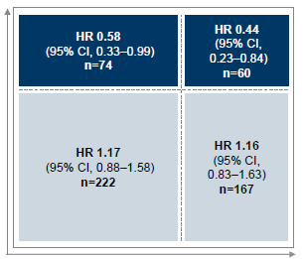
Mystic: Tremelimumab + Durvalumab or Durvalumab vs. Chemotherapy According to bTMB and PD-L1 Expression
Durvalumab vs. Chemotherapy
Durvalumab + Tremelimumab vs. Chemotherapy
PD-L1 <25%
PD-L1 ≥25%
PD-L1 <25%
PD-L1 ≥25%
Rizvi N, ASCO 2019

Slide 25
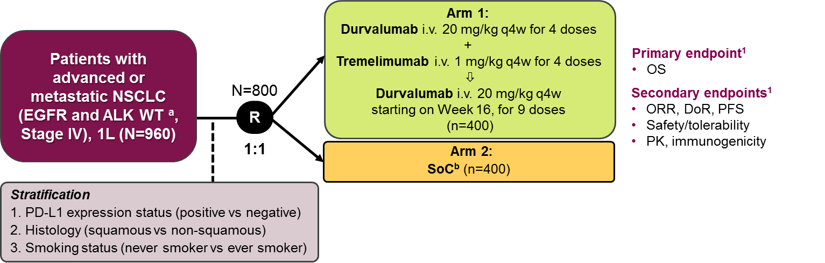
Neptune Phase III trial failed to prospectively validate bTMB as a predictive biomarker for OS
in bTMB≥20 mut/Mb
NEPTUNE
ESMO 2019
21 August 2019 07:00 BST
In the primary analysis population of patients whose blood TMB was ≥ 20 mut/Mb,
the combination of durvalumab and tremelimumab did not meet the primary endpoint
of improving OS compared to SoC chemotherapy.

Slide 26
Strategies of ICIs development in 1st line treatment of advanced NSCLC
Immunotherapy
instead of
chemotherapy
Selection of patients
on predictive biomarkers
PD-L1
Anti-PD(L)-1
as single agent
TMB
Anti-PD(L)-1
+ anti-CTLA-4
Immunotherapy
In combination with
chemotherapy
No patients selection
Non-squamous
Anti-PD(L)-1
+ chemotherapy
according to histology
Squamous

Slide 27
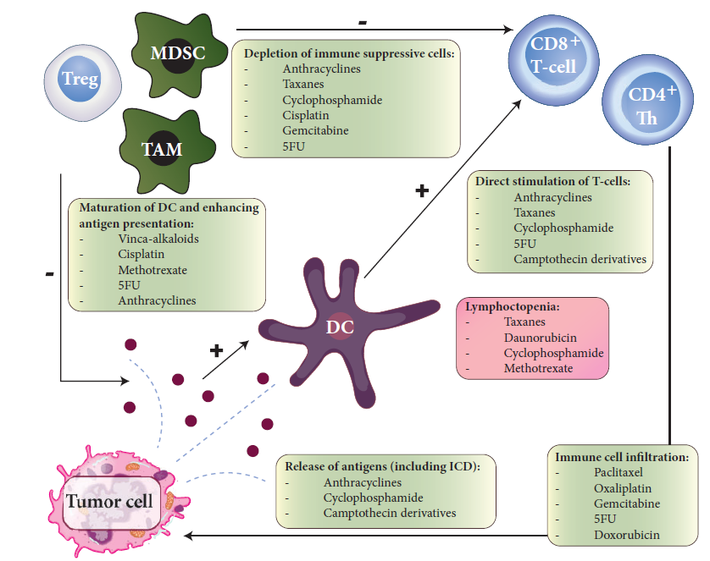
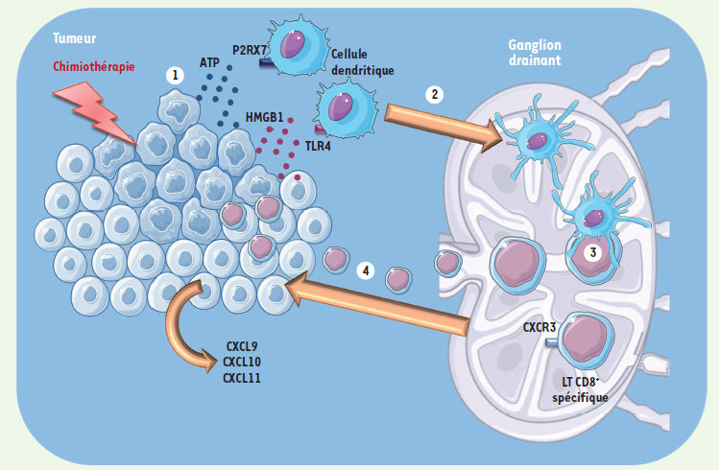
Impact of chemotherapy on immune response
Immunogenic cell death
Impact on tumor microenvironment
Hanoteau, Med Sci 2016; Heinhuis, Ann Oncol 2019

Slide 28
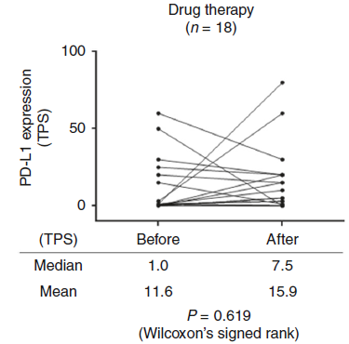
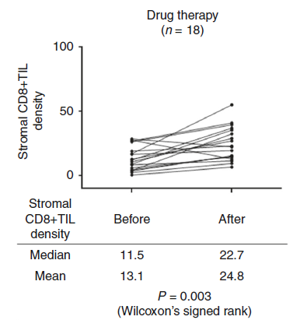
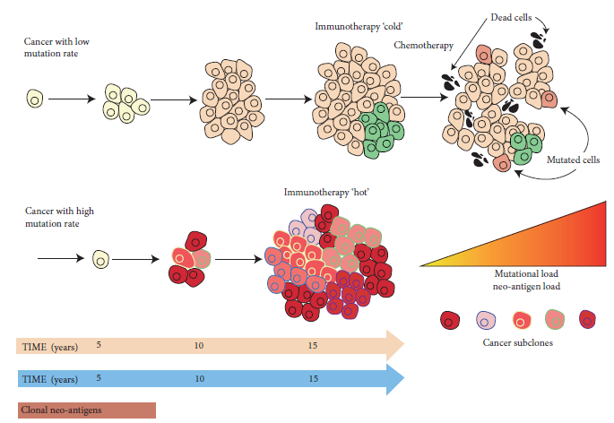
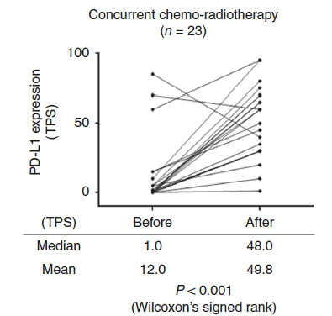
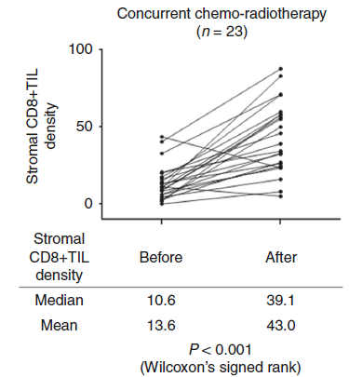
Is chemotherapy really able to convert cold tumors into hot tumors?
CT
PD-L1
CD8+ TIL
CT + RT
Helleday, Ann Oncol 2019; Yoneda, Br J Cancer 2019

Slide 29
Strategy of ICIs development in 1st line treatment of advanced NSCLC: in combination with chemotherapy
Anti-PD(L)-1 + chemotherapy
Immunotherapy
In combination with
chemotherapy
No patients selection
Non-squamous
Keynote 189
Pembrolizumab
CisP/CbP
+ pemetrexed
IMPower 150
Atezolizumab
CbP-paclitaxel
± bevacizumab
IMPower 130
Atezolizumab
CbP
+ nab-paclitaxel
IMPower 132
Atezolizumab
CisP/CbP
+ pemetrexed
Squamous
Keynote 407
Pembrolizumab
CisP/CbP + paclitaxel
ou nab-paclitaxel
IMPower 131
Atezolizumab
CisP/CbP + paclitaxel
ou nab-paclitaxel
All histologies
Checkmate 227 Part 2
Nivolumab
Chimiothérapie
Poseidon
Durvalumab ± treme.
Chimiothérapie

Slide 30
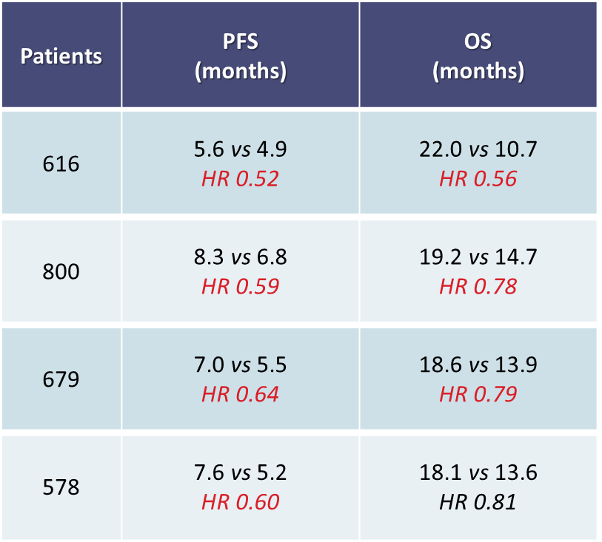
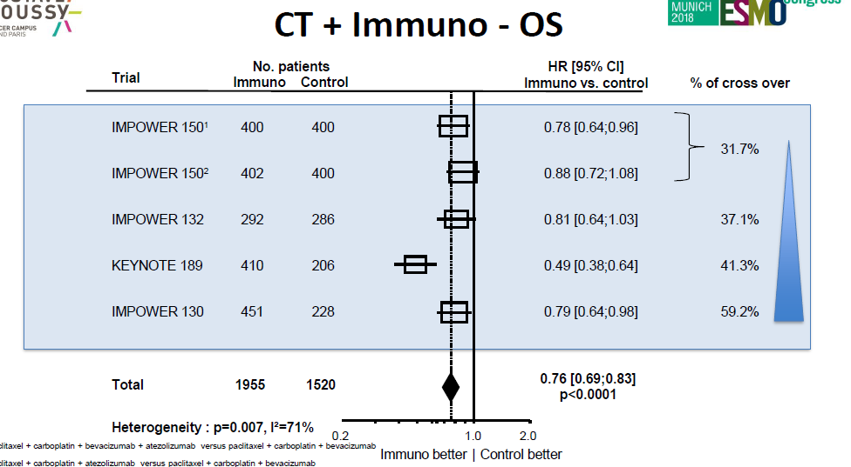
Strategy of ICIs development in 1st line treatment of advanced NSCLC: in combination with chemotherapy
Anti-PD(L)-1 + chemotherapy
Non-squamous
Keynote 189
Pembrolizumab
CisP/CbP
+ pemetrexed
IMPower 150
Atezolizumab
CbP-paclitaxel
± bevacizumab
IMPower 130
Atezolizumab
CbP
+ nab-paclitaxel
IMPower 132
Atezolizumab
CisP/CbP
+ pemetrexed
Gandhi KN189, NEJM 2018; Socinski, NEJM 2018; Papadimitrakopoulou, WCLC 2018; Cappuzzo, ESMO 2018; Gadgeel, ASCO 2019

Slide 31
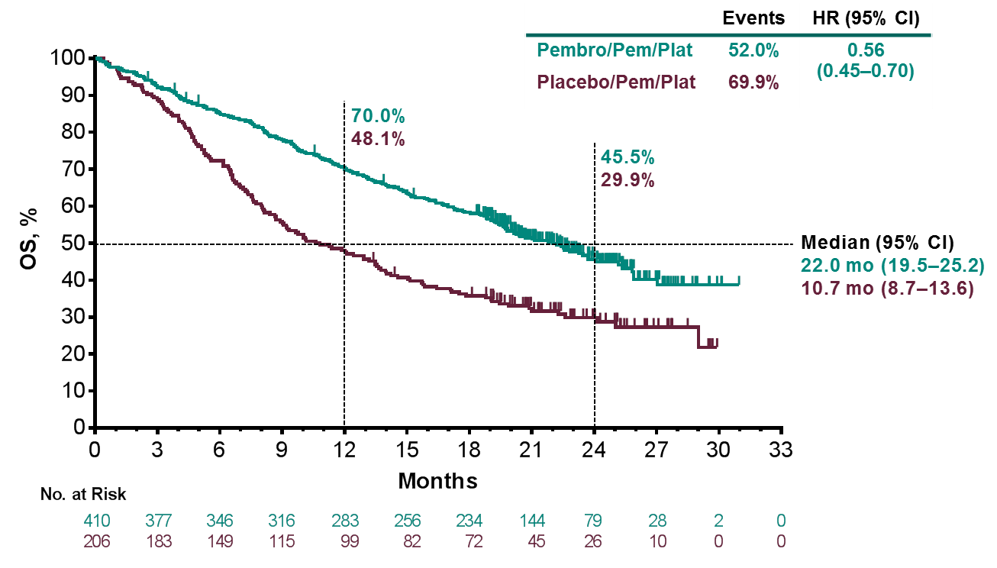
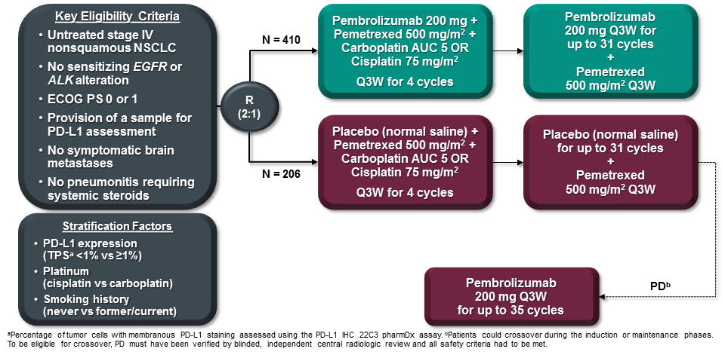
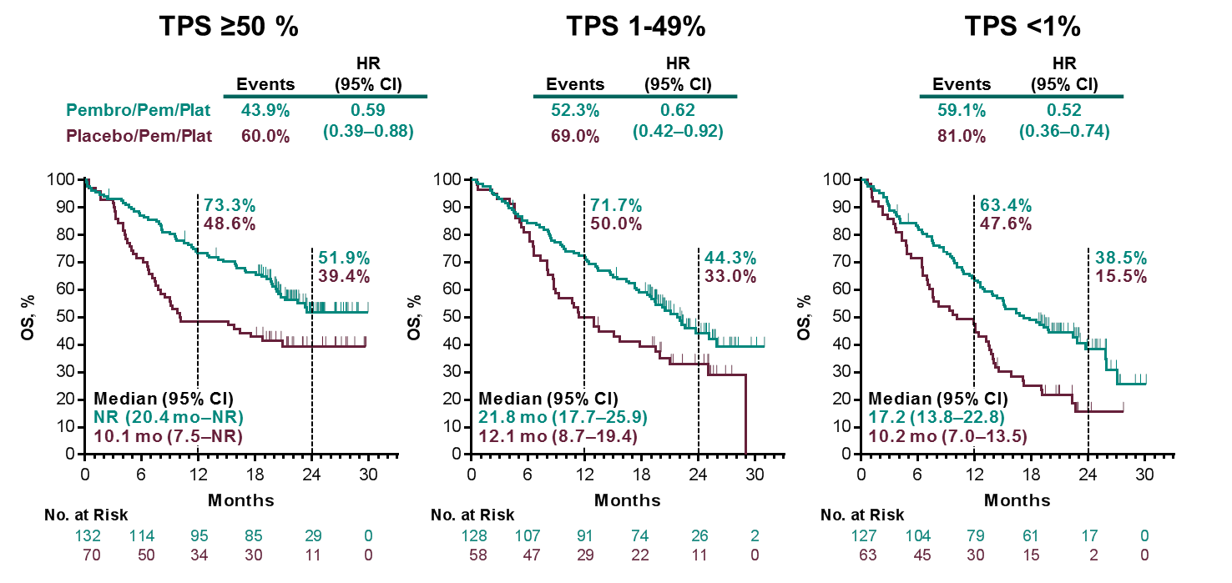
Chemotherapy ± anti-PD-1
Keynote 189 (non-squamous NSCLC)
Gandhi KN189, AACR 2018 and NEJM 2018; Gadgeel, ASCO 2019

Slide 32
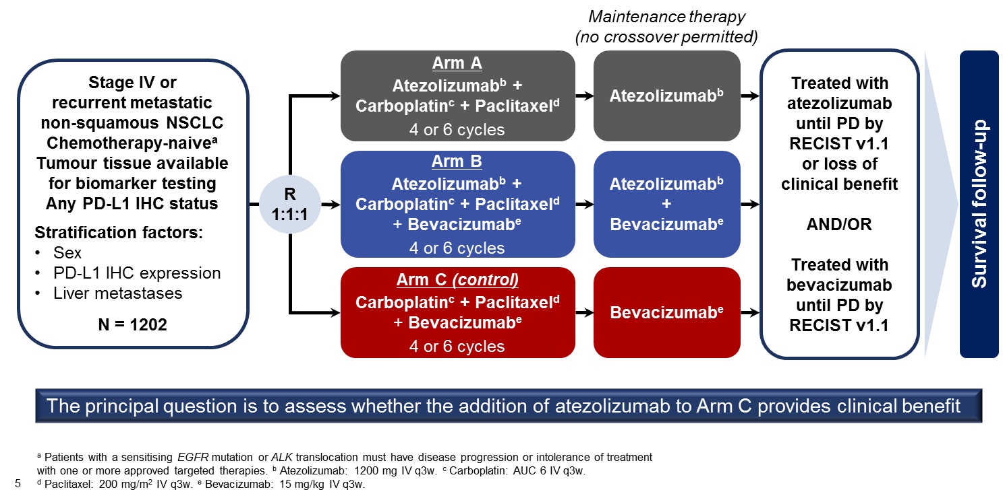
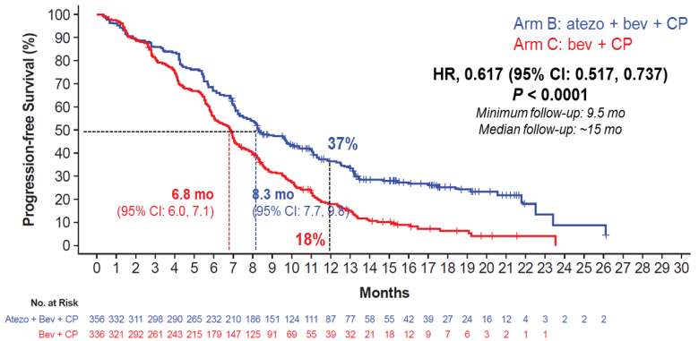
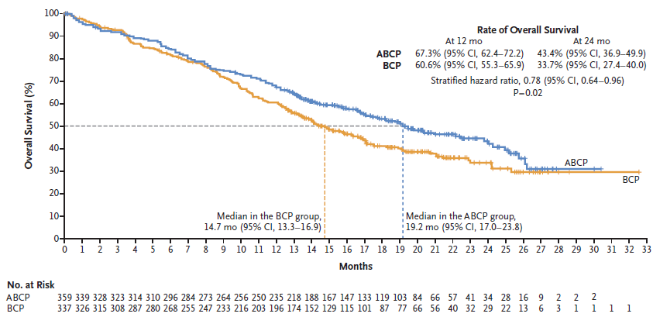
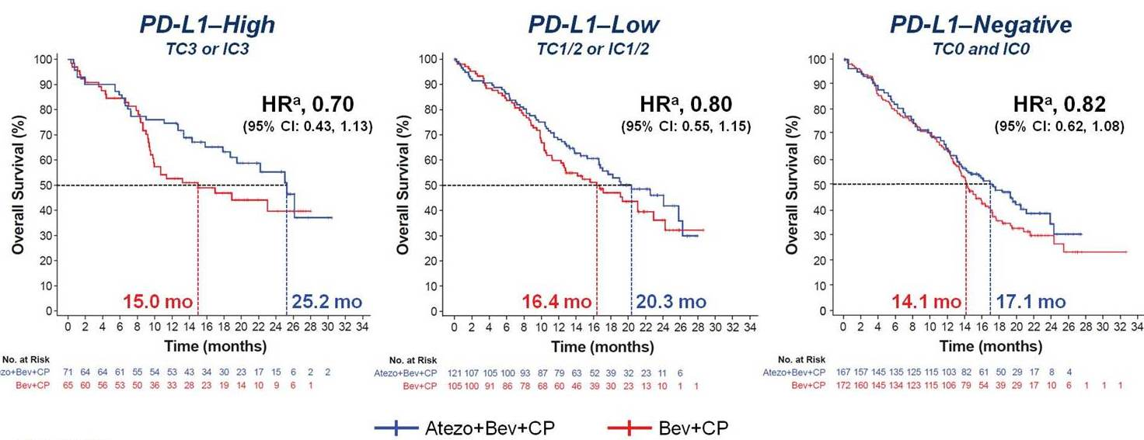
Chemotherapy + Bevacizumab ± Anti-PD-L1
IMPower 150 (non-squamous NSCLC)
Socinski, ASCO 2018 and NEJM 2018

Slide 33
Strategy of ICIs development in 1st line treatment of advanced NSCLC: in combination with chemotherapy
Squamous
Anti-PD(L)-1 + chemotherapy
Patients | PFS (months) | OS (months)
559 | 6.4 vs 4.8 HR 0.56 | 15.9 vs 11.3 HR 0.64
684 | 6.5 vs 5.6 HR 0.75 | 14.2 vs 13.5 HR 0.88
Keynote 407
Pembrolizumab
CisP/CbP + paclitaxel
ou nab-paclitaxel
IMPower 131
Atezolizumab
CisP/CbP + paclitaxel
ou nab-paclitaxel
Paz-Ares, NEJM 2018; Jotte, ASCO 2018; Cappuzzo, WCLC 2019

Slide 34
Summary of ICIs Development in 1st Line
ICIs Instead of Chemotherapy
Patients selection(PS 0-1): PD-L1, TMB
Anti-PD(L)-1
as single agent
Anti-CTLA4
+ Anti-PD(L)-1
All histologies
KN
024
KN
042
CM
026
Mystic
CM 227
Part 1a
CM 227
Part 1a
Mystic
Neptune
PD-L1
≥50%
PD-L1
≥1%
PD-L1
≥5%
PD-L1
≥25%
PD-L1
≥1%
TMB
≥10
PD-L1
≥25%
bTMB
≥20
Pembro
Pembro
Nivo
Durva
Ipi + Nivo
Ipi + Nivo
Treme+
Durva
Treme+
Durva
PFS
OS
Pembro : pembrolizumab, Ipi : ipilimumab ; Nivo : nivolumab ; Durva : durvalumab; Treme : tremelimumab ; Atezo : atezolizumab ; bev : bevacizumab

Slide 35
Summary of ICIs Development in 1st Line
ICIs in addition to Chemotherapy
No patients selection (PS 0-1)
Chemotherapy + Anti-PD(L)-1
Non-squamous
Squamous
All histologies
KN
189
IMPower
132
IMPower
130*
IMPower
150*
KN
407
IMPower
131
CM 227
Part 1b
No selection on PD-L1
PD-L1 <1%
CT
+ Pembro
CT
+ Atezo
CT
+ Atezo
CT + bev
+ Atezo
CT
+ Pembro
CT
+ Atezo
CT
+ nivo
PFS
OS
*: inclusion of patients with EGFR mutations and ALK rearrangement; Pembro : pembrolizumab, Ipi : ipilimumab ; Nivo : nivolumab ; Durva : durvalumab; Treme : tremelimumab ; Atezo : atezolizumab ; bev : bevacizumab

Slide 36
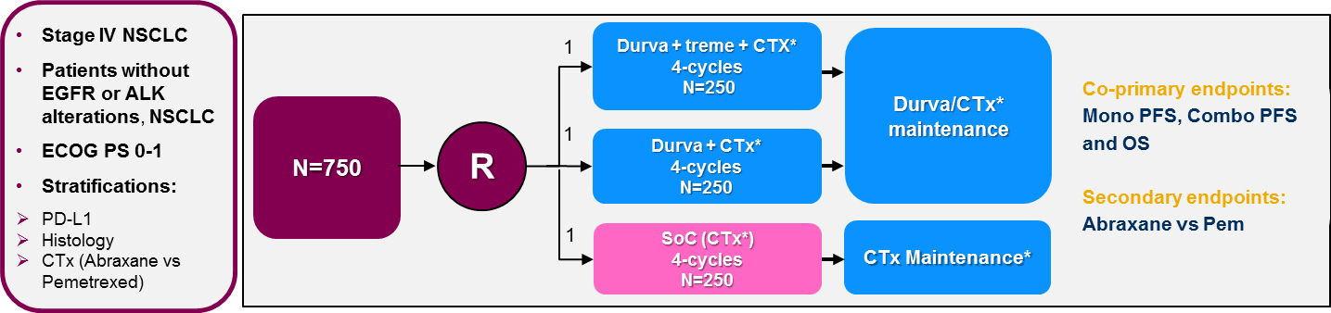
Ongoing/completed 1st line trials
POSEIDON

Slide 37
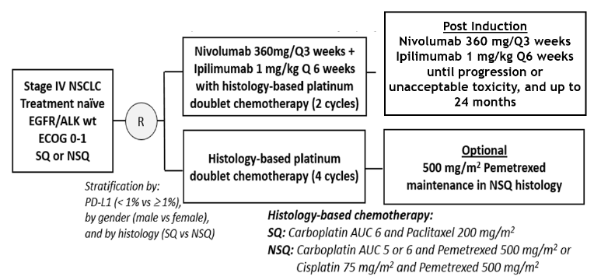
Ongoing/completed 1st line trials
CA209-LA
Primary endpoint: OS
Secondary endpoints
PFS by BIRC
ORR by BICR
Predictive impact of TMB on ORR, PFS and OS
Tertiary endpoints
Safety
bTMB
Gene expression signatures
ADA
QoL
PFS2

Slide 38
A new treatment algorithm

Slide 39
Advanced NSCLC without targetable oncogenic addiction
First line treatment algorithm
Histology
Non-Squamous
Squamous
Biomarkers
EGFR wild-type, no BRAF V600E mutation
No ALK or ROS1 rearrangement
PD-L1
PD-L1<50%
PD-L1≥50%
PD-L1<50%
Eligibility
Comorbidities, eligibility to anti-angiogenic therapy
Eligibility to immunotherapy
Comorbidities
Eligibility to immunotherapy
Cis(carbo)platin-pemetrexed
+ pembrolizumab
or carboplatin-paclitaxel-bevacizumab + atezolizumab
Pembrolizumab or
cis(carbo)platin-pemetrexed
+ pembrolizumab
or carboplatin-paclitaxel-bevacizumab + atezolizumab
Pembrolizumab
or
Carboplatin-paclitaxel
+ pembrolizumab
Carboplatin-paclitaxel
+ pembrolizumab
Induction
Maintenance
Bevacizumab + atezolizumab
Pemetrexed + pembrolizumab
Pembrolizumab
Pemetrexed + pembrolizumab
Atezolizumab + bevacizumab
Pembrolizumab
Pembrolizumab

Slide 40
Advanced NSCLC without targetable oncogenic addiction
First line treatment algorithm
Histology
Non-Squamous
Squamous
Biomarkers
EGFR wild-type, no BRAF V600E mutation
No ALK or ROS1 rearrangement
PD-L1
PD-L1<1%
PD-L1 1-49%
PD-L1≥50%
PD-L1 1-49%
PD-L1<1%
Eligibility
Comorbidities, eligibility to anti-angiogenic therapy
Eligibility to immunotherapy
Comorbidities
Eligibility to immunotherapy
Cis(carbo)platin-pemetrexed
+ pembrolizumab
or carboplatin-paclitaxel-bevacizumab + atezolizumab
Pembrolizumab or
cis(carbo)platin-pemetrexed
+ pembrolizumab
or carboplatin-paclitaxel-bevacizumab + atezolizumab
Pembrolizumab
or
Carboplatin-paclitaxel
+ pembrolizumab
Carboplatin-paclitaxel
+ pembrolizumab
Induction
Maintenance
Bevacizumab + atezolizumab
Pemetrexed + pembrolizumab
Pembrolizumab
Pemetrexed + pembrolizumab
Atezolizumab + bevacizumab
Pembrolizumab

Slide 41
Treatment strategy remains based
on PD-L1 level of expression

Slide 42
Advanced NSCLC without targetable oncogenic addiction
First line treatment algorithm
Histology
Non-Squamous
Squamous
Biomarkers
EGFR wild-type, no BRAF V600E mutation
No ALK or ROS1 rearrangement
PD-L1
PD-L1<1%
PD-L1 1-49%
PD-L1≥50%
PD-L1 1-49%
PD-L1<1%
Eligibility
Comorbidities, eligibility to anti-angiogenic therapy
Eligibility to immunotherapy
Comorbidities
Eligibility to immunotherapy
Cis(carbo)platin-pemetrexed
+ pembrolizumab
or carboplatin-paclitaxel-bevacizumab + atezolizumab
Pembrolizumab or
cis(carbo)platin-pemetrexed
+ pembrolizumab
or carboplatin-paclitaxel-bevacizumab + atezolizumab
Pembrolizumab
or
Carboplatin-paclitaxel
+ pembrolizumab
Carboplatin-paclitaxel
+ pembrolizumab
Induction
Maintenance
Bevacizumab + atezolizumab
Pemetrexed + pembrolizumab
Pembrolizumab
Pemetrexed + pembrolizumab
Atezolizumab + bevacizumab
Pembrolizumab

Slide 43
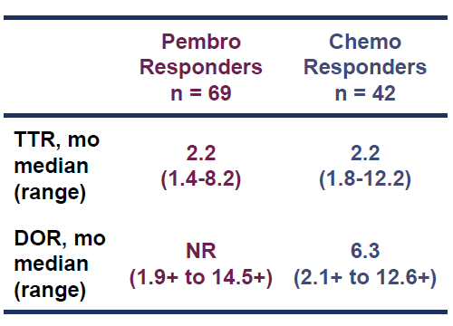
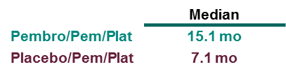
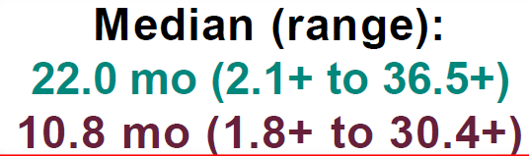
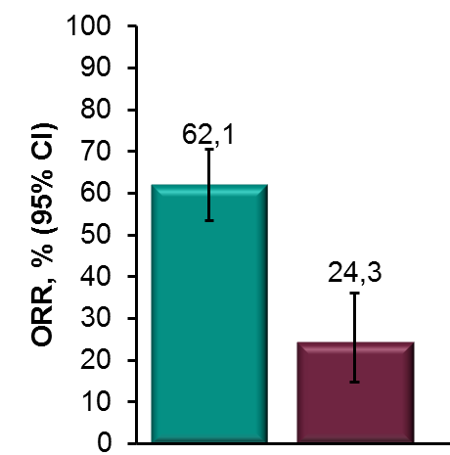
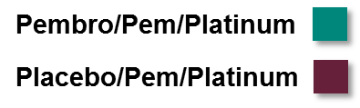
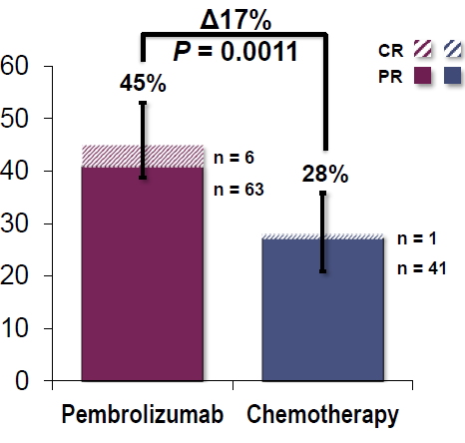

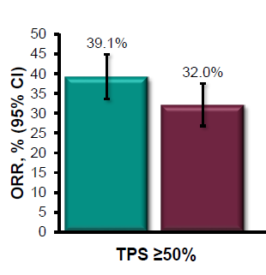
PD-L1 ≥50% : Single agent or Combination?
Response and Duration of Response
Keynote 189
Non-squamous
Keynote 024
All histologies
Keynote 042
All histologies
Reck, NEJM 2016
Gandhi, NEJM 2018
Mok, ELCC 2019

Slide 44
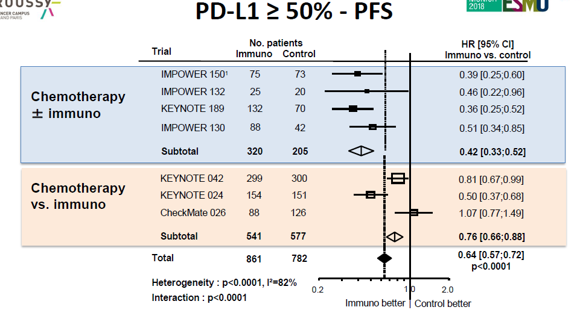

PFS and OS magnitude of benefit in PD-L1 ≥50% NSCLC
Non-squamous
Non-squamous
+ squamous
Besse B, ESMO 2018

Slide 45


PD-L1 ≥50% : Single agent or Combination?
PFS
Keynote 024
Keynote 189
Reck, NEJM 2016; Gandhi, NEJM 2018; Gadgeel, ASCO 2019

Slide 46
PD-L1 ≥50% : Single agent or Combination?
OS
Keynote 024 (Sq + NSq)
Keynote 189 (NSq)
Reck, NEJM 2016; Gandhi, NEJM 2018; Reck, WCLC 2019, Gadgeel, ASCO 2019

Slide 47
Combination IO + CT
Independent Action or Synergy?
PD-L1 ≥ 50%
Anti-PD1 vs. Anti-PD1 + chemotherapy
Combination Chemo + anti-PD1/PD-L1
Synergy
Combination Chemo + anti-PD1/PD-L1
Independent action
Early progression
with pembrolizumab
as single agent
Pembrolizumab single agent ➔ chemo 2nd line

Slide 48
Immunotherapy in 1st Line
Tolerance profile: Monotherapy vs. Combo.
Reck, NEJM 2016; Carbone, NEJM 2017; Hellmann, NEJM 2018; Gandhi L, NEJM 2018; Socinski, NEJM 2018; Rizvi, ESMO-IO 2018

Slide 49



Single agent or Combination?
PD-L1 1 – 49%
Chemotherapy
+ Pembrolizumab
Pembrolizumab
single agent
Keynote 042
All histologies
Keynote 189
Non squamous
Keynote 407
Squamous
Gandhi L, NEJM 2018; Paz-Ares, NEJM 2018; Mok, ELCC 2019

Slide 50
Advanced NSCLC without targetable oncogenic addiction
First line treatment algorithm
Histology
Non-Squamous
Squamous
Biomarkers
EGFR wild-type, no BRAF V600E mutation
No ALK or ROS1 rearrangement
PD-L1
PD-L1<1%
PD-L1 1-49%
PD-L1≥50%
PD-L1 1-49%
PD-L1<1%
Eligibility
Comorbidities, eligibility to anti-angiogenic therapy
Eligibility to immunotherapy
Comorbidities
Eligibility to immunotherapy
Cis(carbo)platin-pemetrexed
+ pembrolizumab
or carboplatin-paclitaxel-bevacizumab + atezolizumab
Pembrolizumab or
cis(carbo)platin-pemetrexed
+ pembrolizumab
or carboplatin-paclitaxel-bevacizumab + atezolizumab
Pembrolizumab
or
Carboplatin-paclitaxel
+ pembrolizumab
Carboplatin-paclitaxel
+ pembrolizumab
Induction
Maintenance
Bevacizumab + atezolizumab
Pemetrexed + pembrolizumab
Pembrolizumab
Pemetrexed + pembrolizumab
Atezolizumab + bevacizumab
Pembrolizumab

Slide 51





Should every patient be treated with 1st line ICI?
PD-L1 <1%
TPS <1%
Keynote 189
Non-squamous
ImPower 130
Non-squamous
ImPower 150
Non-squamous
Keynote 407
Squamous
Gandhi L, NEJM 2018; Socinski, NEJM 2018; Cappuzzo, ESMO 2018; Paz-Ares, ASCO 2018; Gadgeel, ASCO 2019

Slide 52



Pooled analysis of KN 21G, KN 189 and KN 407 in PD-L1<1% NSCLC
Borghaei, WCLC 2019

Slide 53
Is there a room for additional biomarkers?

Slide 54


TMB is independant of PD-L1 level of expression
CheckMate 026, WES
Mystic, blood TMB
Peters, AACR 2017; Rizvi, ASCO 2019

Slide 55



Using tmb and pd-l1 as Two Independent Biomarkers
Gandara, Nat Med 2018; Peters S et al., AACR 2017

Slide 56

Checkmate 227 Part 1b (PD-L1<1%): PFS
Nivolumab + Chemotherapy and Nivolumab + Ipilimumab by TMB
Borghaei H, ASCO 2018

Slide 57

TMB as a Decision-Making Biomarker: the Next Step?

Slide 58

TMB (WES) is not predictive for OS benefit in Chemotherapy + ICI vs. Chemotherapy trials
Garassino M et al., WCLC 2019

Slide 59
Main Unmet Need:
Second-Line Therapy

Slide 60

Algorithme de traitement

Slide 61

Post-Immunotherapy Treatment: Different Scenarios
PFS (%)
Primary resistance /hyperprogression
Anti-PD-1 alone
vs. chemotherapy-IO combination
Resistance mechanisms
Durable benefit
Retreatment
Acquired resistance
after PR/SD
Checkmate 063: Nivolumab as ≥ 3rd Line
in Advanced Squamous Cell Carcinoma
Impact of free interval between treatment discontinuation and relapse
Rizvi, Lancet Oncol 2015

Slide 62

Keynote 024
Outcome of patients completing 35 cycles
Reck, WCLC 2019

Slide 63

KeyNote 024
Patients Who Received a Second-Course Treatment
Reck, WCLC 2019

Slide 64


Mécanismes de résistance à l’immunothérapie
Résistance intrinsèque à la cellule tumorale
Sharma, Cell 2017
Notes:
En ce qui concerne l'étude des mécanismes de résistance à l'immunothérapie, on peut identifier une résistance intrinsèque et une extrinsèque.
Les patients qui présentent une résistance primaire à l’immunotherapie ne répondent pas au traitement initial. Les études en cours indiquent que les facteurs intrinsèques et les facteurs extrinsèques de la tumeur peuvent contribuer aux mécanismes de résistance.
Les facteurs intrinsèques qui contribuent à la résistance à l'immunothérapie comprennent l'expression ou la répression de certains gènes et des voies dans les cellules tumorales qui empêchent l'infiltration des cellules immunitaires ou la fonction dans le microenvironnement tumoral. Ces mécanismes peuvent exister au moment de la présentation initiale, mettant en évidence les mécanismes de résistance primaire, ou ces mécanismes peuvent évoluer plus tard, mettant en évidence les mécanismes de résistance adaptative.

Slide 65


Mécanismes de résistance à l’immunothérapie
Résistance extrinsèque à la cellule tumorale (microenvironnement)
Sharma, Cell 2017
Notes:
Les mécanismes extrinsèques des cellules tumorales qui conduisent à une résistance primaire et/ou adaptative impliquent des composants autres que les cellules tumorales dans le microenvironnement tumoral, y compris les Tregs, les cellules suppressives dérivées de myéloïde (MDSC), les macrophages M2 et d'autres points de contrôle immunitaires, qui peuvent tous contribuer à inhiber les réponses immunitaires anti-tumorales.

Slide 66

Rationale for Combinations
Courtesy of S. Peters

Slide 67

PIONEER: Precision immuno-oncology for advanced NSCLC patients with PD-(L)1 resistance
PI : F. Barlesi

Slide 68
Conclusions

Slide 69


All patients eligible for ICIs will receive anti-PD(L)-1 in 1st line treatment
Anti-PD(L)-1 become the cornerstone of the 1st line treatment of advanced NSCLC, either as single agent for pembrolizumab or in combination with chemotherapy
  ICIs have increased of ≈20% the proportion of patients alive at 1 year
  > 60% patients will experience disease progression during the 1st year of treatment despite CT+ anti-PD(L)-1
Keynote 189
Gandhi, NEJM 2018

Slide 70
PD-L1 Still Remains the Only Decision-Making Biomarker
PD-L1 ≥50%
  SoC = pembrolizumab as monotherapy
  Addition of chemotherapy: prevents early disease progression, no obvious evidence of synergy, cost of increased toxicity
PD-L1 <50%
  SoC = combination of anti-PD(L)-1 + chemotherapy
  Some patients probably do not need the addition of ICIs : low TMB + PD-L1 <1%?
Need for additional biomarkers
  TMB might be the next step but not ready for the prime time yet: feasibility, standardization, turn around time, cost; more impactful for anti-CTLA-4 combinations, no prospective validation for OS
Second-line therapy must be rethought …

Slide 71


Vers un développement
plus rationnel …
Tang et al., Nature Rev Drug Discov 2018; Galon, Nat Rev Drug Discov 2019

